Slide 1

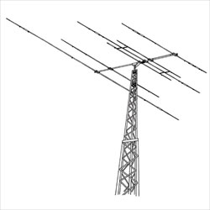
Digital Operations and JS8CALL
Bellbrook Amateur Radio Club tech night
Bob French, AC8ZU
AC8ZU@arrl.net

Slide 2
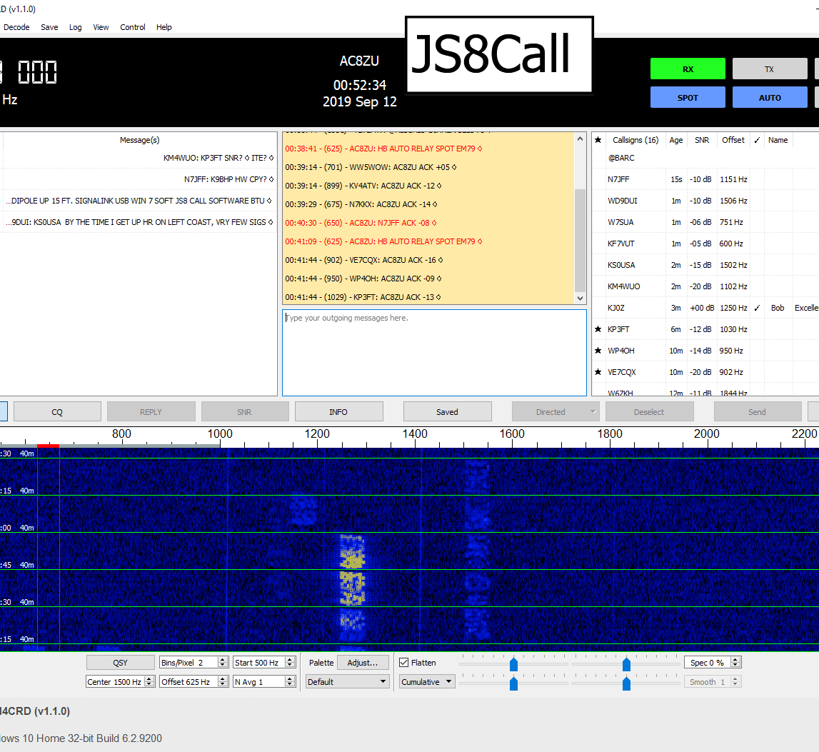
Content
Learning
JS8Call
  Overview
  JS8Call Functionality
  Directed Messages
  Heart Beat & Auto Actions
  Tips & Tricks
  Emergency Usage?
  Configuration

Slide 3

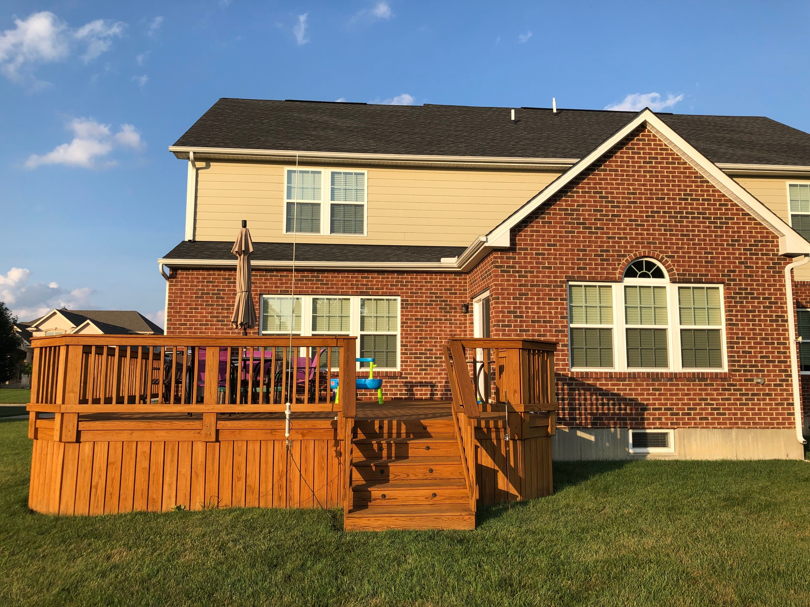
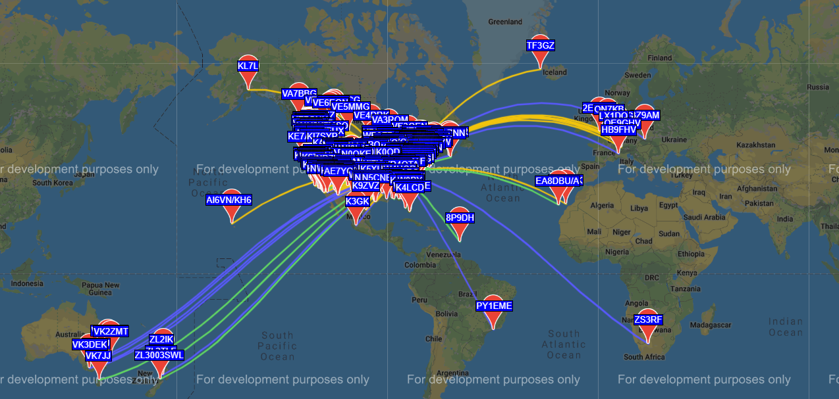
Learning
Tech License thru Extra License 2017
Worst Antennae
Blowing Breakers (ARCI)
The Enemy - HOA & RFI
Experiment
WSPR
Winter Solution
Notes:
arc-fault circuit interrupter (AFCI)
1st HF Radio

Slide 4
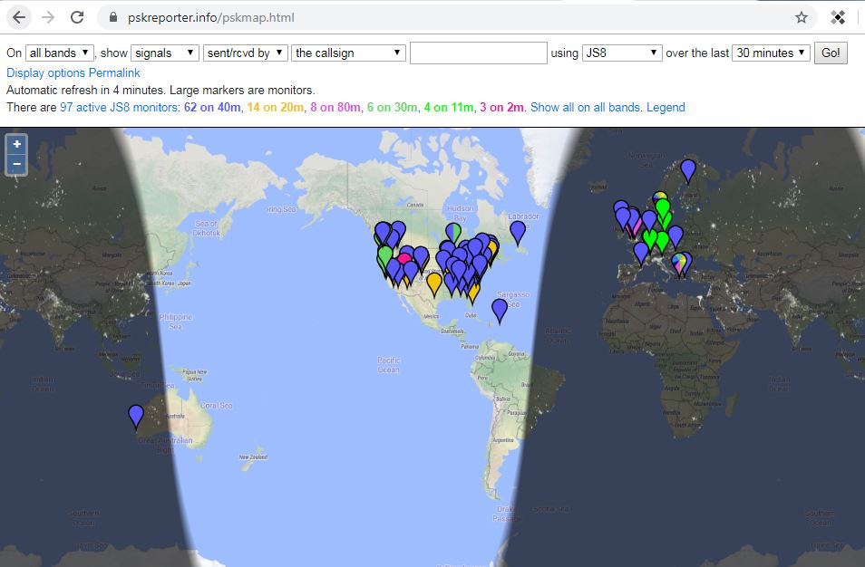
JS8Call Overview
Build on WSJT-X code base
Rag Chew Abilities using weak signal communication
Free text messages similar to PSK31
Directed messages (short cuts)
Automated beacon
Automatic Replies (On / Off Toggle)
Mail box messaging for Later Retrieval ,
Message Relay
Call Logging

Slide 5
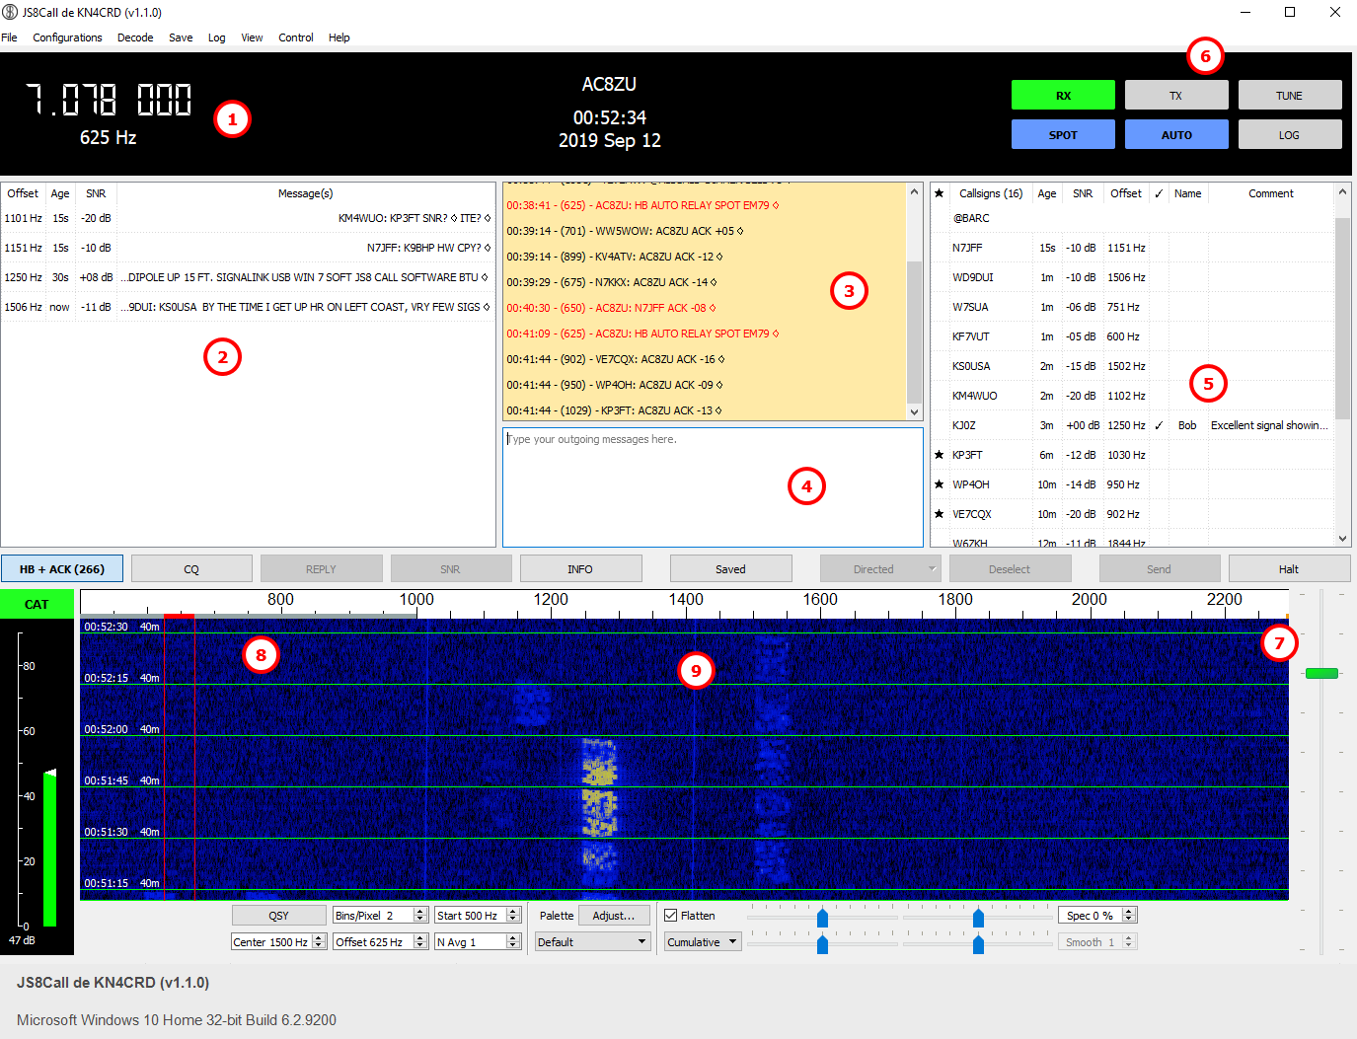
JS8Call Functionality
Notes:
1 – change Frequency 2 – CQ in progress , 3 – Your actions , your CQ, etc. 4 – Area to type free txt, directed commands txt , 5 Heart Beat , callsigns seen, groups

Slide 6
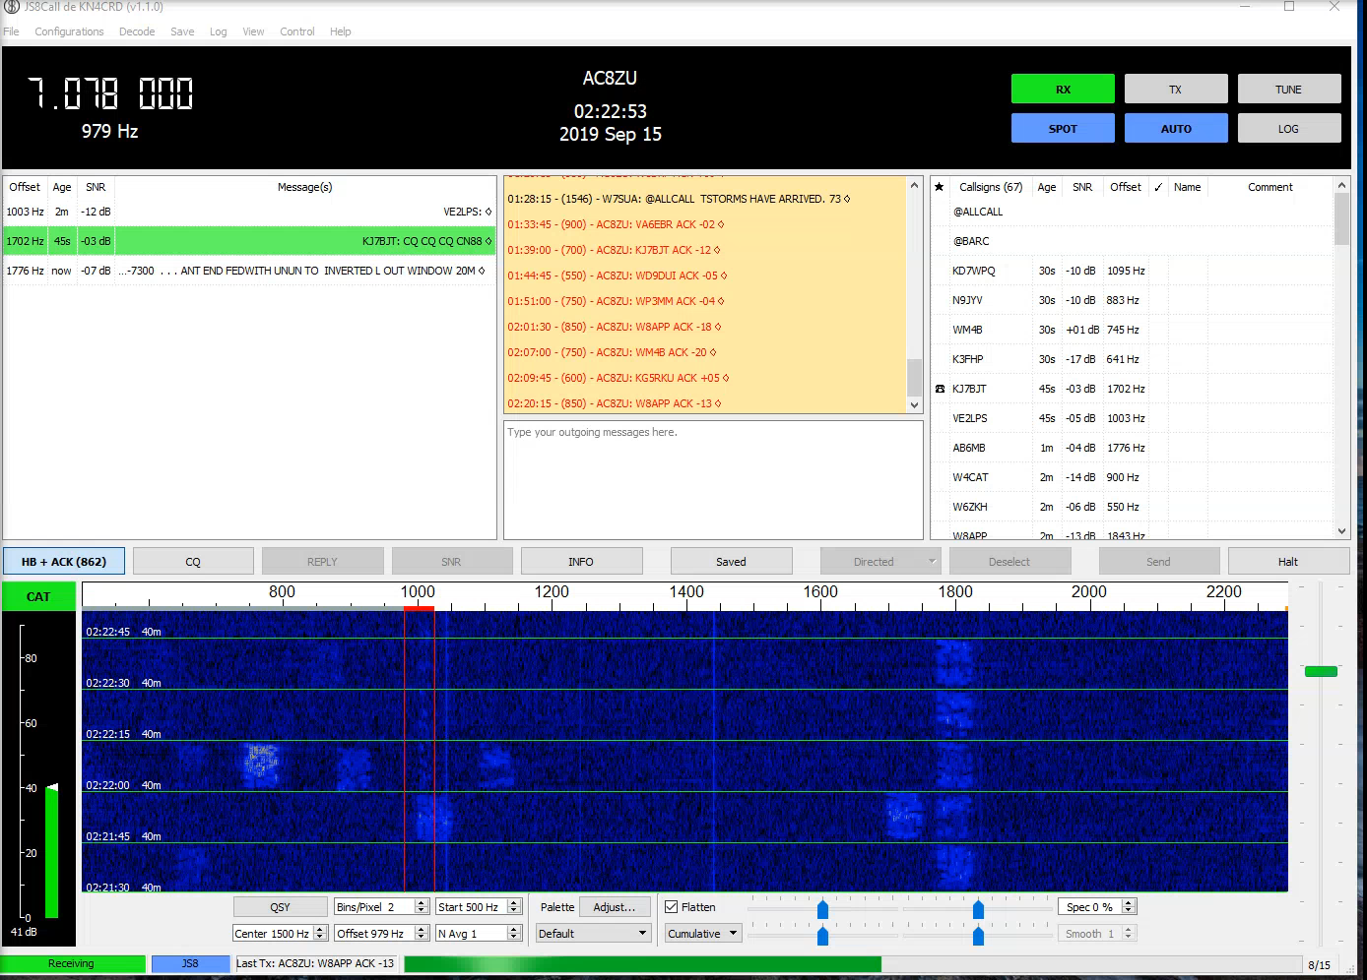
CQ
Notes:
CQ in Process video

Slide 7
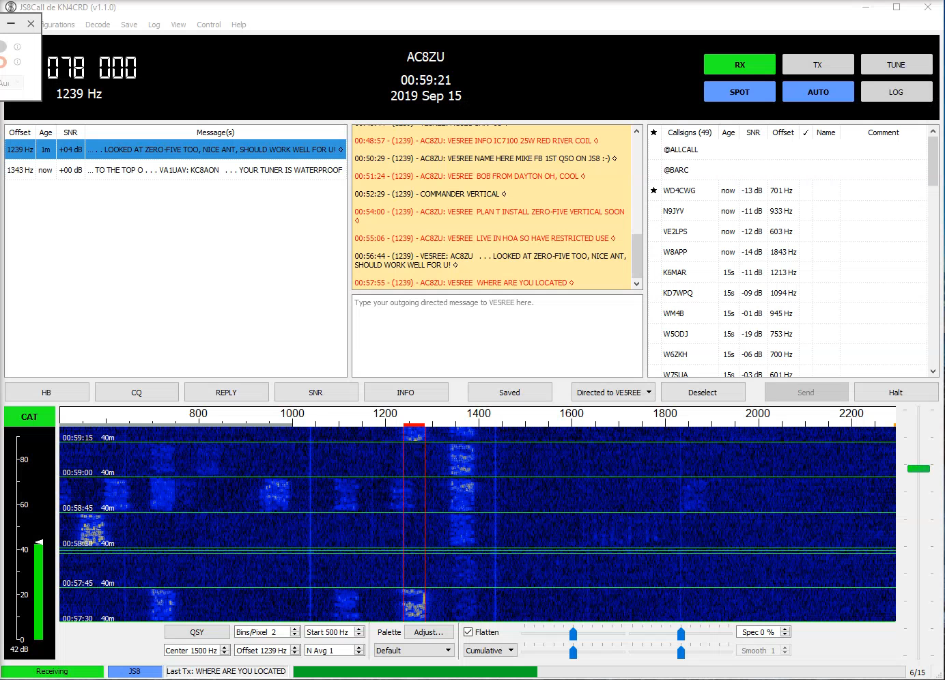
Notes:
Demo for Presentation – CQ with Sarkisian, Canada 25w . 40 red river coil

Slide 8
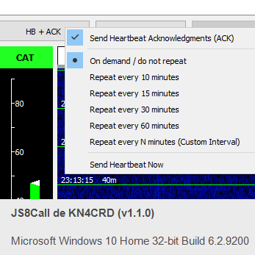
Heart Beat & Auto Actions
Notes:
Heart Beat & Auto Actions

Slide 9
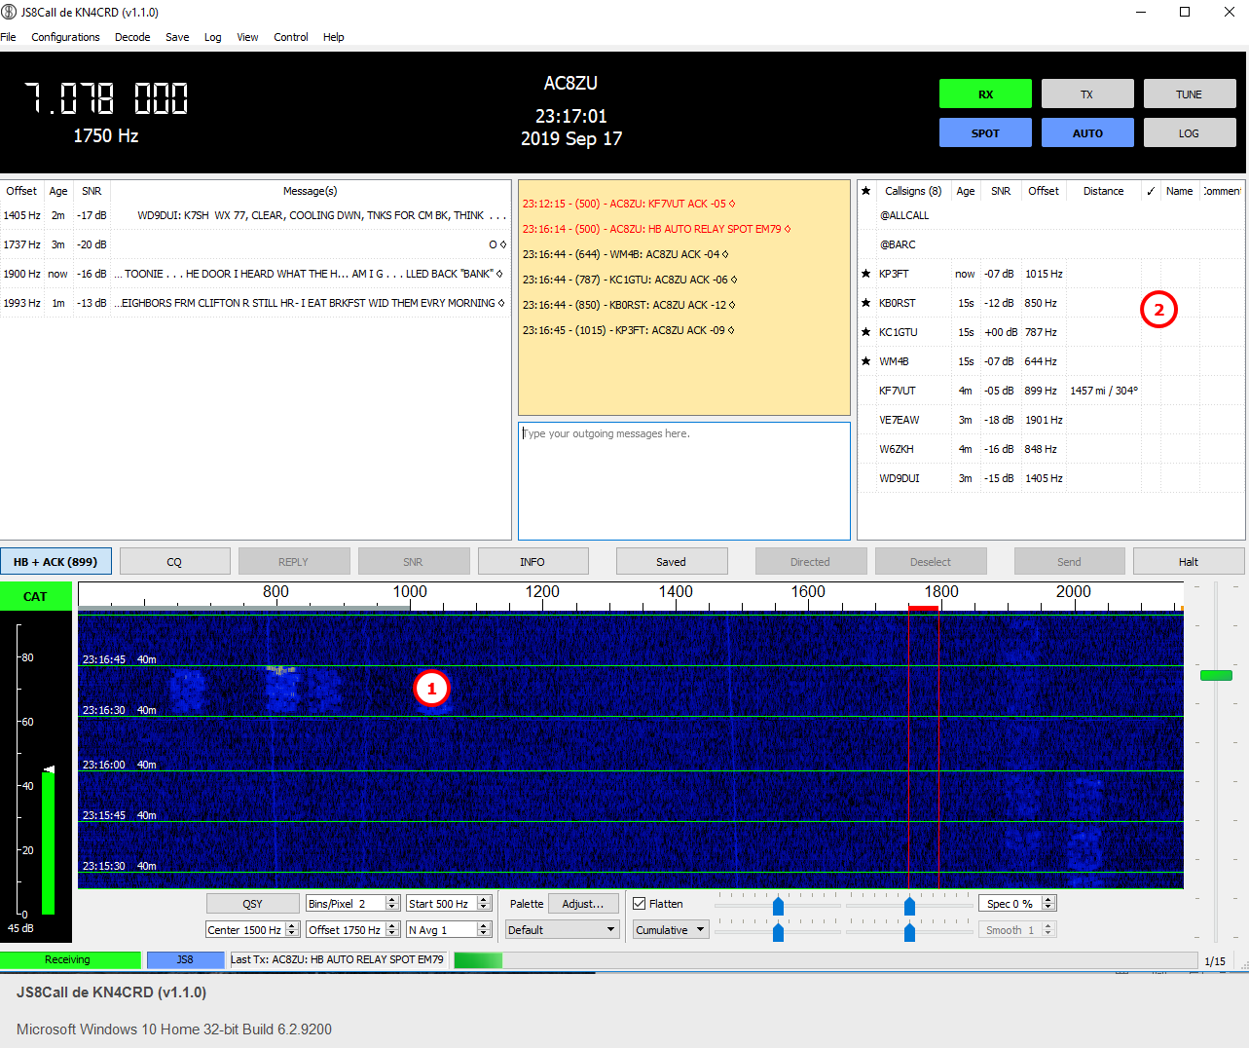
Heart Beat
Notes:
Heart Beat & Auto Actions

Slide 10
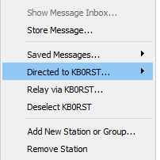
Auto Button
If auto Enabled and not in Direct/Select Mode:
JS8Call allows users to send commands to other stations,
Example Signal Report Request you hear or in CQ:
  right click on that station,
  select the Directed to <CALLSIGN> menu option,
  select “? – What is my signal report?” and
  JS8Call will sent the signal report query to the station
Notes:
Heart Beat & Auto Actions

Slide 11
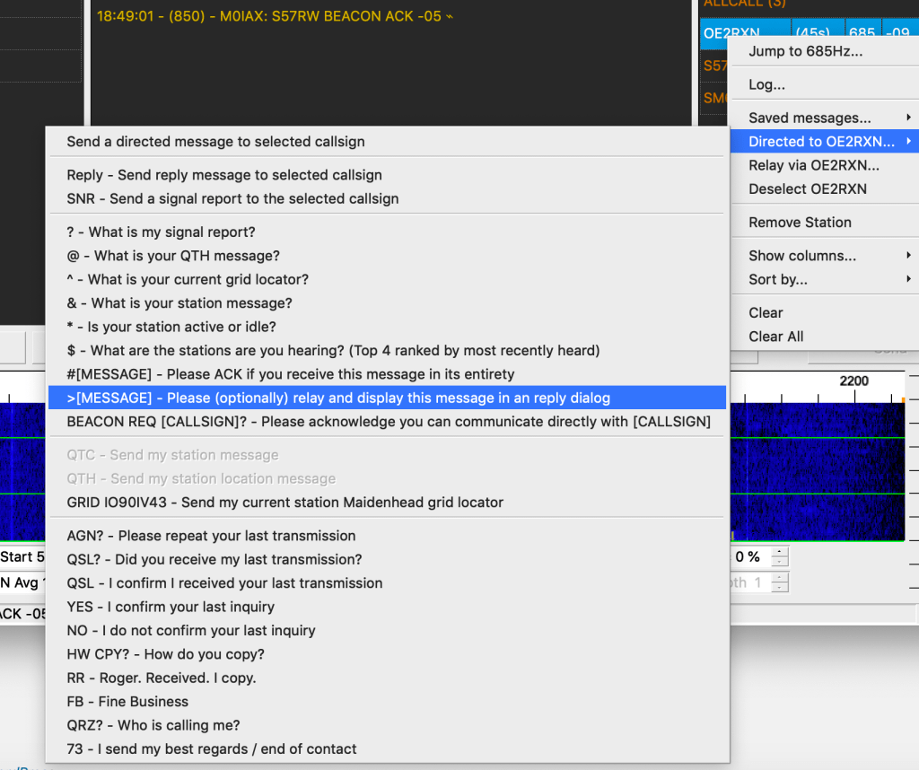
Directed Messages
Some Available commands (build in pull down, do not need to memorize):
? – What is my SNR?
@ – What is your QTH (station location)?
& – What is your QTC (station message)?
$ – What stations are you hearing? (Will transmit the top 4 ranked by SNR)
QSO [CALLSIGN]? – Can you communicate directly with CALLSIGN?
>message – Please (optionally) relay this message and display it in a reply dialog.
#message – Please ACK if you receive this message in its entirety
AGN? – Have the station automatically retransmit their last message
—
QTC – Send station message
QTH – Send location message
GRID – Send a long-form grid locator (to be spotted on a map via PSKReporter & APRS-IS)
—
QSL? – Did you receive my last transmission?
QSL – I received your last transmission
YES – I confirm your last inquiry
NO – I negative confirm your last inquiry
HW CPY? – How do you copy?
RR – Roger. Received. I copy.
FB – Fine Business
QRZ? – Who is calling me?
73 – I send my Best Regards / End of Contact
….

Slide 12
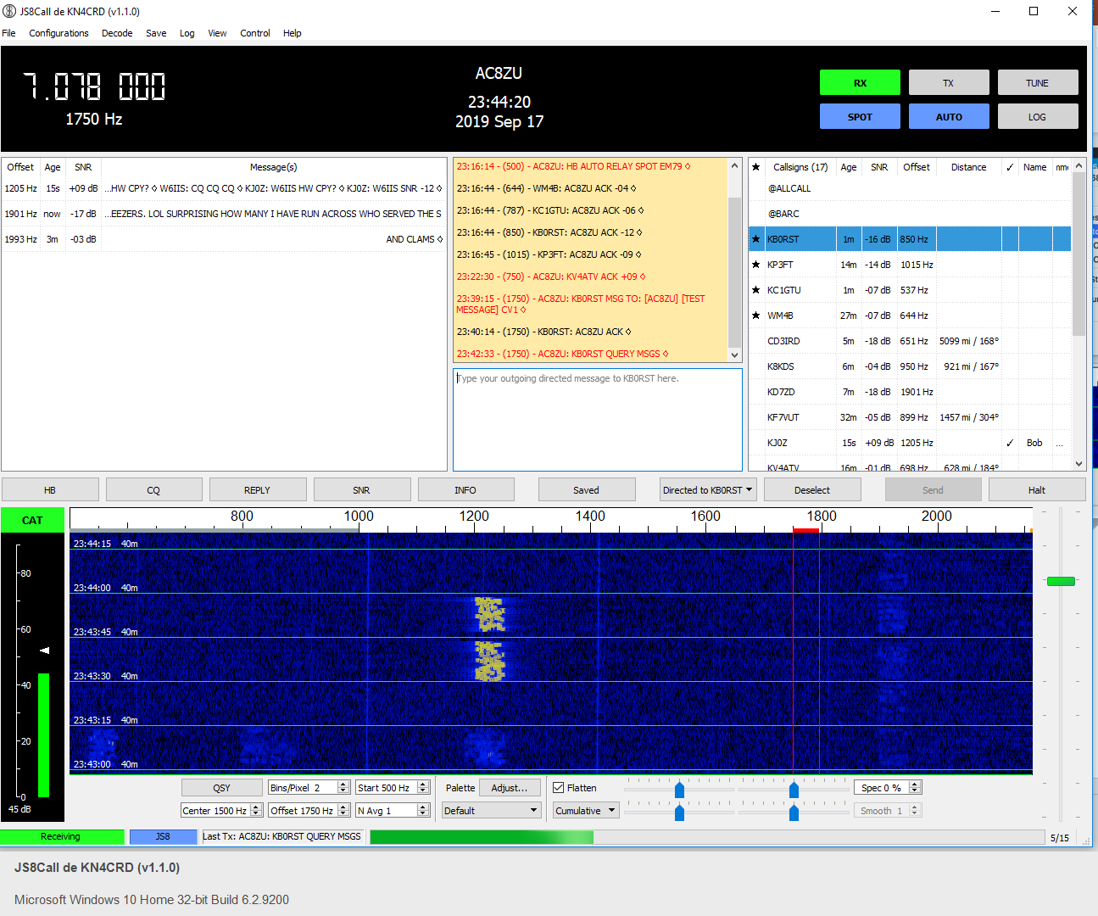
Message Example

Slide 13
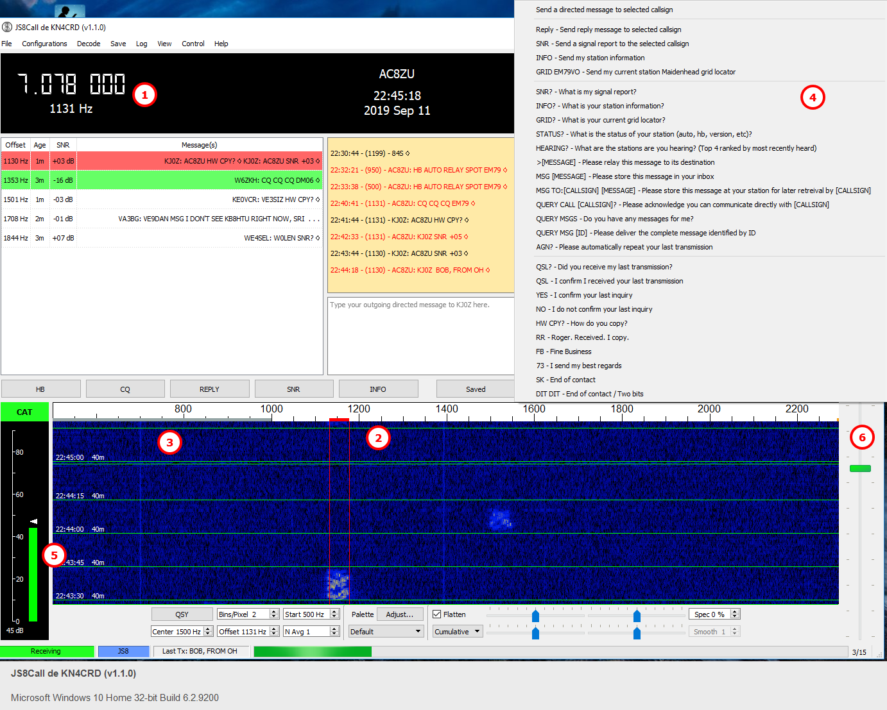
Tips & Tricks
Switching between WSJT-X check frequency
Region for communications
Heart Beat only – will go automatically for HB
Direct Command eliminates remembering commands
Make sure Green is 20+ don’t let it go red Adjust RF gain simplest way
Controls Output (Transmit watts on radio)

Slide 14
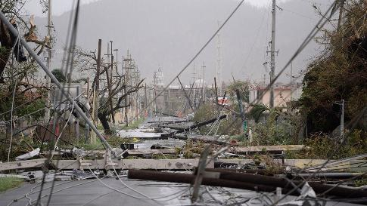
Emergency Usage?
Original Interest - Keeping Communications Flowing During Large-Scale Disasters (BMERS, much more sophisticated solution with HAM Radio Operators and Government)
Text vs Verbal, Words can be misheard
Ability to work on all licensed bands (VHF, UHF, HF)
Send location to the APRS Network
Capabilities included (relays, stored message, auto response. Standard and un standard messaging
Setup communication Groups (BARC, etc.)
APRS using JS8Call Video - https://youtu.be/mQxmhPqcQzA

Slide 15
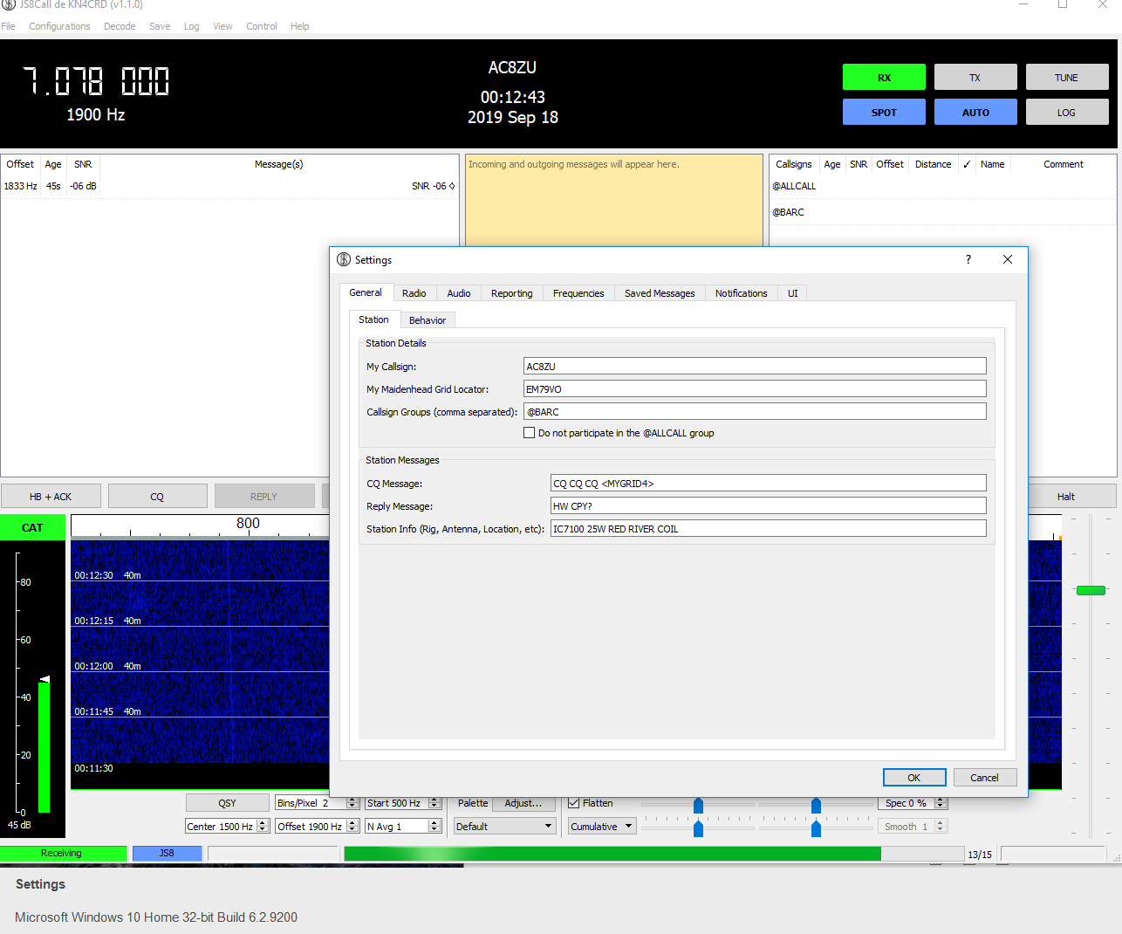
  Configuration (Click File – Setup)

Slide 16
Thank you
AC8ZU@arrl.net
BARC Website for copies of this presentation at bellbrookarc.org

